Slide 1
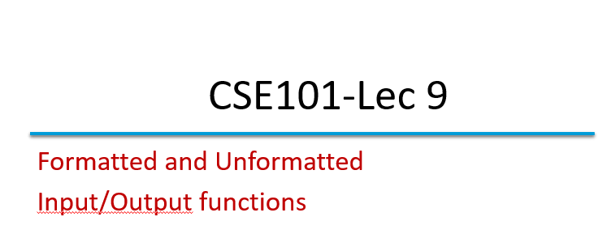

Slide 2
Introduction
Presentation of output is very important.
Formatted functions scanf and printf :
these functions input data from standard input stream and
output data to standard output stream.
Include the header #include<stdio.h>

Slide 3
Standard I/O Functions
There are many library functions available for standard I/O.
These functions are divided into two categories:
–Unformatted functions
–Formatted functions

Slide 4
Formatted Functions
With Formatted functions, input and output is formatted as per our requirement
For example, if different values are to be displayed, how much field width i.e., how many columns on screen, is to be used, and how much space between two values is to be given. If a value to be displayed is of real type, then how many decimal places to output
Formatted functions are:
printf()
scanf()

Slide 5
Formatted output with printf function
The printf() function: (Formatted output)
printf() is an output function that takes text and values from within the program and sends it out onto the screen.
In general terms, the printf function is written as:
The format-control-string can contain:
Characters that are simply printed as they are
Conversion specifications that begin with a % sign
Escape sequences that begin with a \ sign
The arguments can be written as constants, single variable or array names, or more complex expressions.
Syntax
printf(“format-control-string”, arg1,arg2,……….,argN);

Slide 6
Example
printf(“Area of circle is %f units \n”, area);
In this :-
“Area of circle is %f units \n”- is a control string.
area - is a variable whose value will be printed.
%f- is the conversion specifier indicating the type of corresponding value to be printed.

Slide 7
Formatted Functions
The scanf() function: (Formatted input)
scanf() is a function that reads data from the keyboard. It interprets character input to the computer and stores the interpretation in specified variable(s).
In general terms, the scanf function is written as:
The format-control-string can contain:
Describes the format of the input.
Conversion specifications that begin with a % sign.
The arguments are the pointers to variables in which the input will be stored.
Syntax
scanf (format-control-string, arg1, arg2,………., argN);

Slide 8
Example:
scanf(“%s %d %f”, name, &age, &salary);
In this :-
“%s %d %f”- is a control string.
name – is a string argument and it’s a array name and implicit memory address reference.
age - is a decimal integer variable preceded by &.
salary - is floating-point value preceded by &.

Slide 9
Reading data
Conversion Specifier | Description
d | Read signed decimal integer
i | Read a signed decimal integer
u | Read an unsigned decimal integer
h or l | Used before any integer conversion specifier to indicate that a short or long integer is to be input, respectively
e, E, f, g, G | Read a floating-point value
c | Read a character
s | Read a string
p | Read an address
% | Skip the percent sign(%) in the input

Slide 10
#include <stdio.h>
int main( void )
{ int a, c;
float f;
char day[10];
printf( "Enter integers: " );
scanf( "%d %u", &a, &c);
printf( "Enter floating-point numbers:" );
scanf( "%f", &f);
printf( "%s", "Enter a string: " );
scanf( "%8s", day );
}
Enter integers: -89 23
Enter floating-point numbers:
1.34256
Enter a string:
monday

Slide 11
Output?
int main()
{
int a=6543;
printf("*%5d,*%-5d*",a,a);
return 0;
}
A) *56543,*56543*
B) * 6543,*6543 *
C) *6543 ,* 6543*
D) *6543,*6543*

Slide 12
Output?
int main()
{
int a=123;
printf("*%06d*",a);
return 0;
}
A) *123*
B) *6123*
C) *000123*
D) *006123*

Slide 13
Output?
int main()
{
float a=654.123456f;
printf("%3.3f,%3.2f",a,a);
return 0;
}
A) 654,654
B) 654.123456,654.123456
C) 654.123,654.12
D) 654.000,654.00

Slide 14
Unformatted functions
The unformatted functions work only with character data type.
They do not require format conversion symbol for formatting of data types because they work only with character data type
Unformatted functions are:
getchar() and putchar()
getch() and putch()
gets() and puts()

Slide 15
Unformatted Functions
C has three types of I/O functions:
Character I/O
String I/O
File I/O

Slide 16
getchar()
This function reads a character-type data from standard input.
It reads one character at a time till the user presses the enter key.
Example:
char c;
c = getchar();
Syntax
Variable-name = getchar();

Slide 17
#include<stdio.h>
void main()
{
char c;
printf(“enter a character”);
c=getchar();
printf(“c = %c ”,c);
}
Enter a character k
c = k

Slide 18
putchar()
This function prints one character on the screen at a time which is read by standard input.
Example: char c= ‘c’;
putchar (c);
Syntax
putchar( variable name);

Slide 19
#include<stdio.h>
void main()
{
char ch;
printf(“enter a character: ”);
scanf(“%c”, ch);
putchar(ch);
}
enter a character: r
r

Slide 20
Output?
int main()
{
char ch='A';
ch=getchar();
putchar(ch);
return 0;
}//input= S
A) A
B) B
C) S
D) Compiler error

Slide 21
getch() & getche()
These functions read any alphanumeric character from the standard input device
The character entered is not displayed by the getch() function until enter is pressed
The getche() accepts and displays the character.
The getch() accepts but does not display the character.
Syntax
getche();

Slide 22
#include<stdio.h>
void main()
{
printf(“Enter two alphabets:”);
getche();
getch();
}
Enter two alphabets a

Slide 23
putch()
This function prints any alphanumeric character taken by the standard input device
Example:
#include<stdio.h>
void main()
{
char ch;
printf(“Press any key to continue”);
ch = getch();
printf(“ you pressed:”);
putch(ch);
}
Press any key to continue
You pressed : e

Slide 24
gets()
String I/O
This function is used for accepting any string until enter key is pressed (string will be covered later)
Syntax
char str[length of string in number];
gets(str);

Slide 25
#include<stdio.h>
void main()
{
char ch[30];
printf(“Enter the string:”);
gets(ch);
printf(“Entered string: %s”, ch);
}
Enter the string: Use of data!
Entered string: Use of data!

Slide 26
puts()
This function prints the string or character array. It is opposite to gets()
Syntax
char str[length of string in number];
gets(str);
puts(str);

Slide 27
#include<stdio.h>
void main()
{
char ch[30];
printf(“Enter the string:”);
gets(ch);
puts(“Entered string:”);
puts(ch);
}
Enter the string: puts is in use
Entered string: puts is in use

